Slide 1

Using this Slide Deck
This slide deck is like a workbook. Add in and take out what’s needed.
Use the template slides that work for your presentation. Right-click>Duplicate Slide as needed. Delete the others.
Update an image – Right- click > Change Picture.
The notes panel for some slides contains suggested script. Update this script as needed.
Add your thoughts about the session topic into the Notes Panel. Print notes prior - File>Export>Create Handouts>Notes below slides OR use multiple monitors so the notes panel can be visible.
Contact your SciSoc program manager for support as needed.

Slide 2
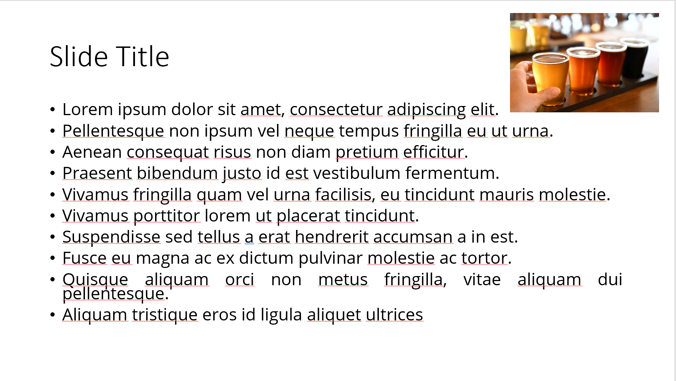
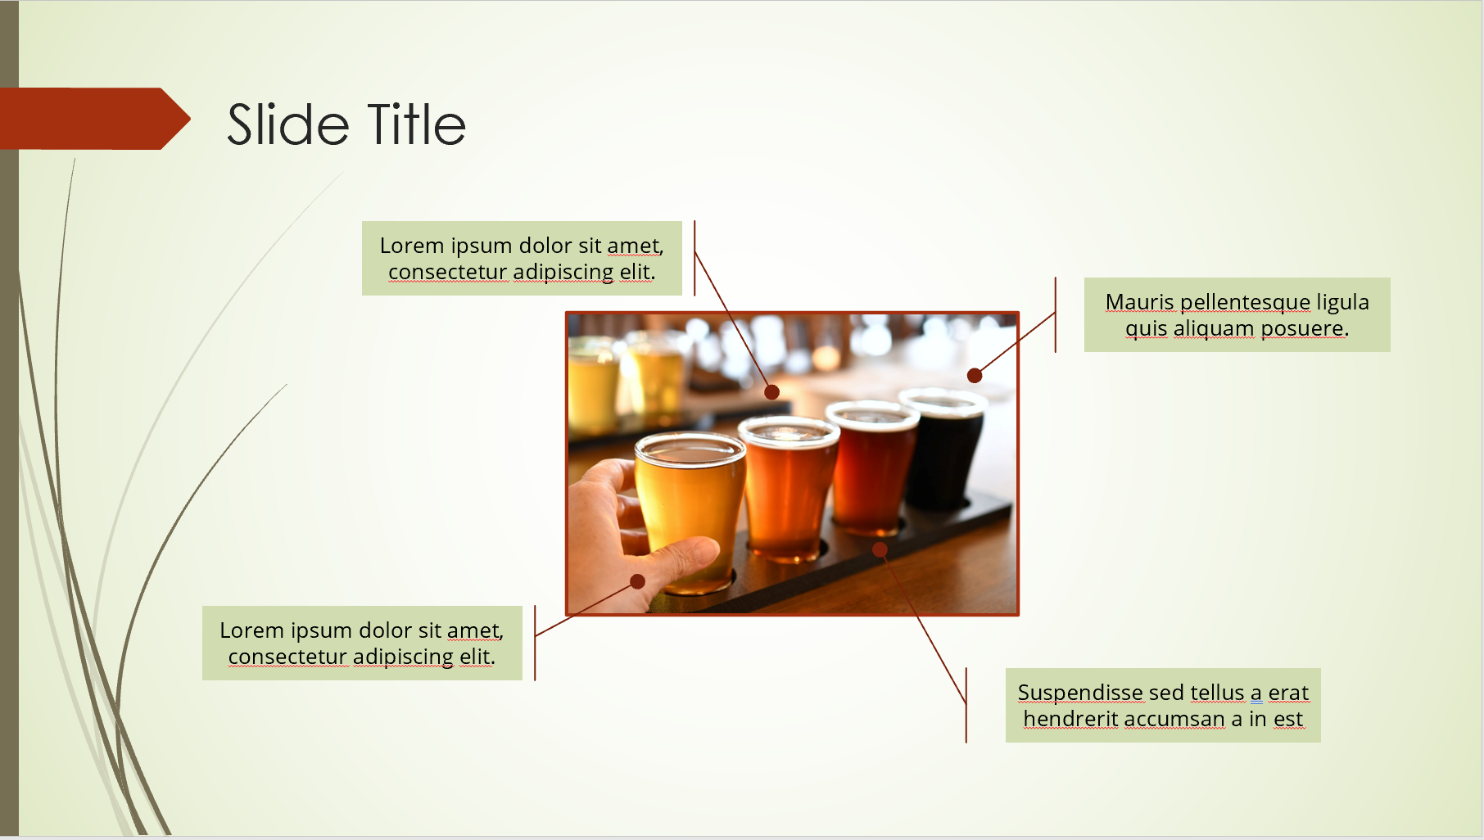
Ensure Slide Clarity
Contact your SciSoc program manager for support as needed.
Notes:
The clarity of your slide and what you put on it should enhance your message.
Ensure the following:
Ample white space. Don’t crowd the slide.
Ideally 1-2 ideas discussed per slide.
Avoid dense bullet point slides and a content dump. Put those details in your notes instead.
Aim for foreground/background color contrast.
Use purposeful images or illustrations that you can talk to from your presenter notes.

Slide 3

Get Copyright Permission
Contact your SciSoc program manager for support as needed.
This Photo by Unknown Author is licensed under CC BY-NC
Notes:
As a reminder, you must own or have permission to use all media (images, illustration, video) or documentation used in this presentation.
This is an issue that can have financial repercussion to your association and one we are careful to adhere to.

Slide 4

Presentation Title Here
Click on photo to replace

Slide 5
Title and Content Layout
First level bullet
  increase list level for sub-bullets

Slide 6
Two Content Layout
First list level is unbulleted (bold if needed)
  Bulleted text
    Bullet two
      Bullet three
        Bullet four
First list level is unbulleted (bold if needed)
  Bulleted text
    Bullet two
      Bullet three
        Bullet four

Slide 8
test
test

Slide 9

Title, Content, Photo Layout
Right-click the photo to replace it.

Slide 10
Chart or Graph
Use simple gray box for callouts

Slide 11
Icons
Icons can be recolored using shape fill. Icons can be used with yellow hex shape (center vertically & horizontally with shape then group). To resize icon and/or shape, use the shift key to keep the original proportions.

Slide 12
Video Title
Notes:
Ensure some testing prior with another person to ensure audio plays for you as well as others in the meeting. Also adjust sizing to fit monitor or similar. Let your ASBC Program Manager know if you will be using video so we can make the AV team aware.

