Slide 1
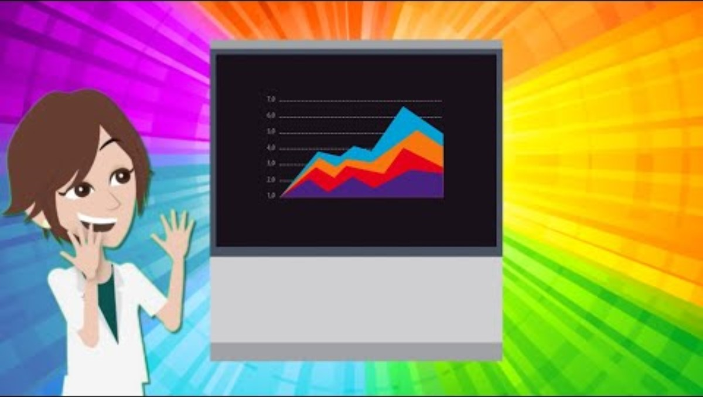
BETTERPOSTERS Resources
https://www.youtube.com/watch?v=SYk29tnxASs
https://betterposters.blogspot.com/
🧠 BIG Takeaway Front and Center
  Use a single, short sentence in giant font in the middle.
  This is your “billboard” message.
  Example: “Fungal enzymes break down plastic faster than expected.”
  Anyone should understand it in 5 seconds—even from across the room.
📦 Organize into 3 Panels
  Introduction / Methods
  (Keep it short and visual—bullets, icons, maybe 1 small figure.)
  Results / Discussion
  (Use charts with clear labels, not text-heavy graphs.)
  Bottom bar or QR code: Details for nerds
  (Put citations, extended data, or a QR to your paper or contact info.)
  👁️ Make it Visual
  Use bold colors, icons, big fonts.
  Don’t overload with text or tiny graphs – Less is more.
  Assume people will skim, not read.
📱 Include a QR code or link
  To your paper, GitHub, contact info, or a video explainer.
  This helps folks follow up after the event.

Slide 2
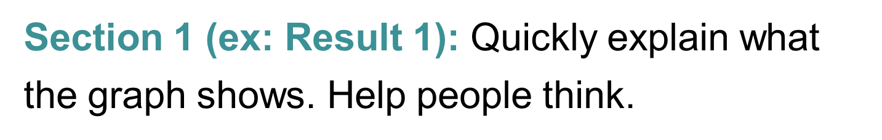
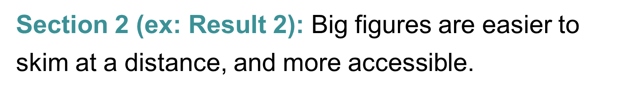

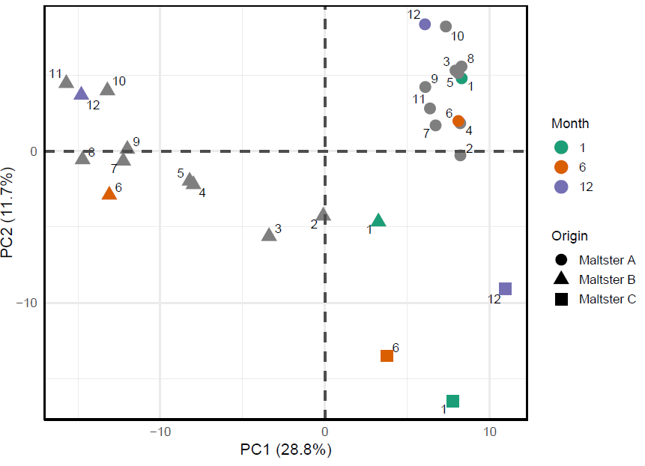
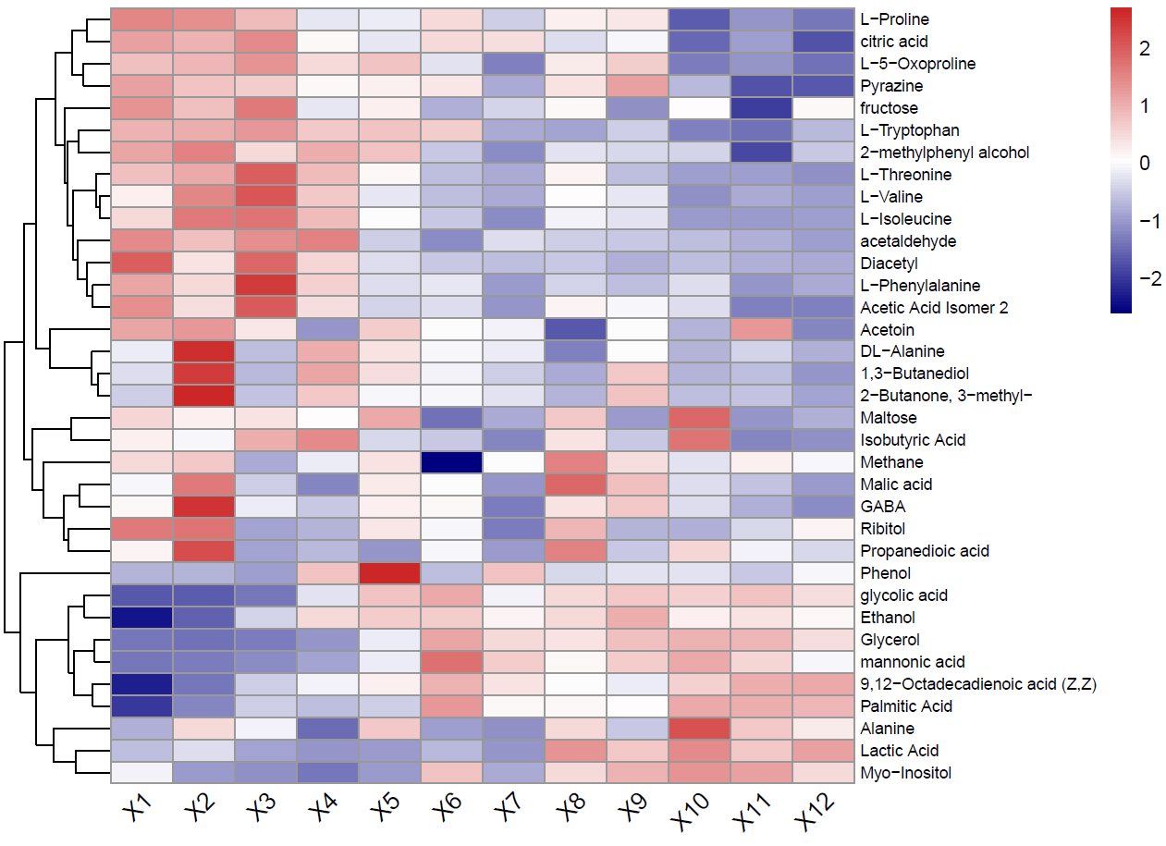
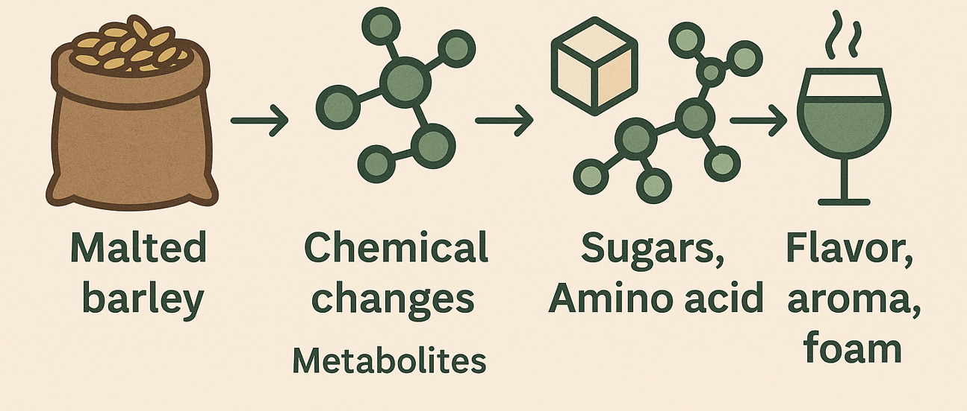
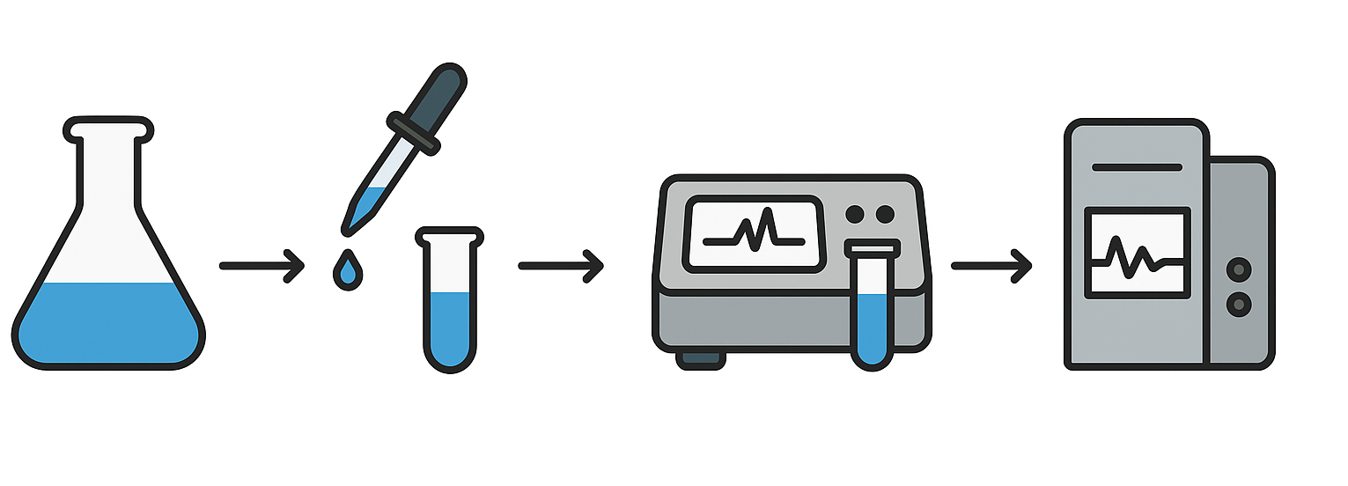
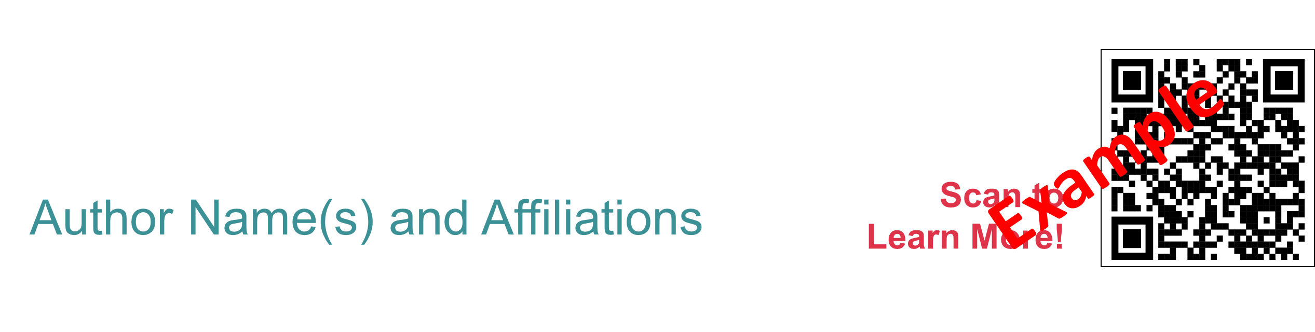
Title goes here: Example - Investigating the
dynamics of X on Y. Extra Space for Long Titles
Background Information: This section should be your problem statement, hypothesis, project justification. Brief, short and sweet to convey the importance of this research.
Sec 3 (e.g. Methods): Use an infographic or photos to demonstrate methods rather than text. Use resources such as BioRender.com, TheNounProject.com, Canva.com, Visme.com, and Powerpoint.
Closing Section: Use this space to include additional information such as acknowledgements, future planned work, KEY takeaways, practical/actionable items for brewers.

Slide 3
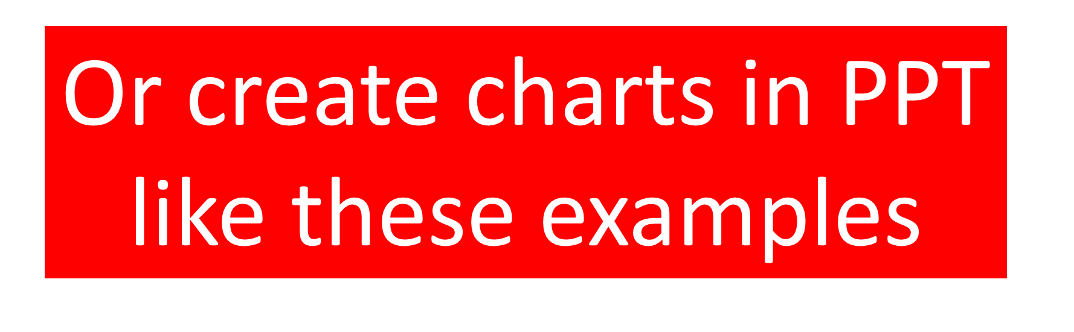

Title goes here: Example - Investigating the
dynamics of X on Y. Extra Space for Long Titles
Background Information: This section should be your problem statement, hypothesis, project justification. Brief, short and sweet to convey the importance of this research.
Sec 3 (e.g. Methods): Use an infographic or photos to demonstrate methods rather than text. Use resources such as BioRender.com, TheNounProject.com, Canva.com, Visme.com, and Powerpoint.
Closing Section: Use this space to include additional information such as acknowledgements, future planned work, KEY takeaways, practical/actionable items for brewers.

Slide 4


Title goes here: Example - Investigating the
dynamics of X on Y. Extra Space for Long Titles
Background Information: This section should be your problem statement, hypothesis, project justification. Brief, short and sweet to convey the importance of this research.
Sec 3 (e.g. Methods): Use an infographic or photos to demonstrate methods rather than text. Use resources such as BioRender.com, TheNounProject.com, Canva.com, Visme.com, and Powerpoint.
Closing Section: Use this space to include additional information such as acknowledgements, future planned work, KEY takeaways, practical/actionable items for brewers.

Slide 5
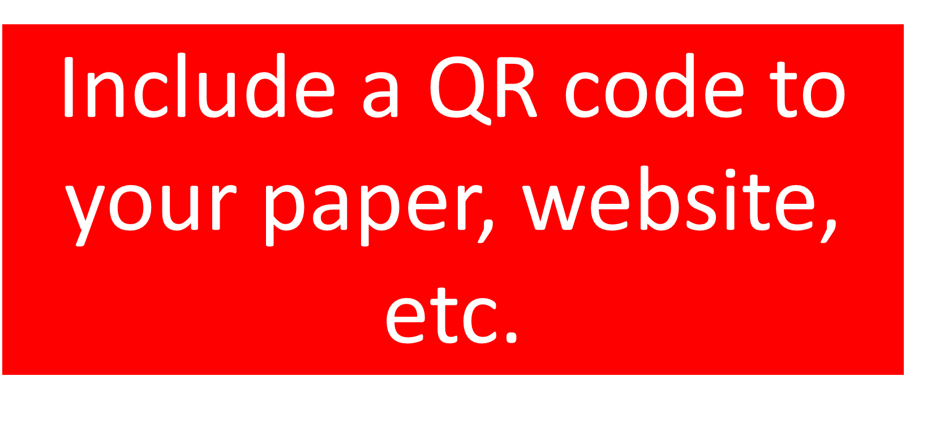
Title goes here: Example - Investigating the
dynamics of X on Y. Extra Space for Long Titles
Background Information: This section should be your problem statement, hypothesis, project justification. Brief, short and sweet to convey the importance of this research.
Sec 3 (e.g. Methods): Use an infographic or photos to demonstrate methods rather than text. Use resources such as BioRender.com, TheNounProject.com, Canva.com, Visme.com, and Powerpoint.
Closing Section: Use this space to include additional information such as acknowledgements, future planned work, KEY takeaways, practical/actionable items for brewers.

